Slide 1

Lecture 01: Concurrency ( Part 1)
(22 slides)

Slide 2
Why should you study this chapter?
This chapter will help you developing a program in which some tasks executing concurrently.
Nowadays, in one program, some tasks execute concurrently. You usually saw them in a web page including texts, sounds, images, games, … changing concurrently.
Nowadays, operating systems (OS) support many programs running concurrently.
Open the Task Manager of Windows OS (Ctrl Alt Delete) to see how many programs are running in your computer.

Slide 3
Review
Concepts introduced in the course OOP using Java:
Object = properties + methods
Benefits of OO Implementation: encapsulation, inheritance, polymorphism
Encapsulation is implemented by modifiers
Inheritance: Subclass inherits declaration of base class (Java is a single inheritance OOP language, the class Object is the ultimate Java class
Polymorphism in Java is implemented by overloading and overriding methods

Slide 4
Review
Class: A template (blueprint) for a group of similar instances
Interface: the core of some classes
Abstract class is a class containing abstract methods (some methods are prototyped only)
Anonymous class: A concrete class developed from an abstract class or an interface but it is not named:
Nested class: a class which is declared in the declaration of the enclosing class
Enum type: Declaration of some constants

Slide 5
Review
Class Declaration:
[public] class ClassName [extends BaseClass] [implements Interface] {
[modifiers] DataType field1 [ = initialValue];
[modifier] ClassName (params) { // constructor
<code>
}
[modifier] methodName(params) { // method
<code>
}
}
Creating objects: ClassName obj = new ClassName(params)
Accessing an object: obj.field or obj.methodeName(args)

Slide 6
Objectives
Multi-Processing System
Threads and Multi-Threading Program
Thread Fundamentals in Java

Slide 7
1- Processes and Multi-Processing System
Program: An executable file (data + code) stored in secondary memory(disk).
Process: A program in running. It’s data and code are loaded to RAM in a contiguous memory block.
Multi-Processing System: An operating system allows some processes running concurrently
Data
P1
Code
Data
P2
Code
Data
P3
Code
Data
P4
Code

Slide 8
Processes and Multi Processing System…
A process has a self-contained execution environment. A process generally has a complete, private set of basic run-time resources; in particular, each process has its own memory space.
Multi Processing/ Multi Tasking System: Almost of operating systems allows many processes executing concurrently.
Open the Task Manager of Windows OS ( Ctrl+Alt+Del) to see current processes in your computer.
Applications tag contains processes which you start them.
automatically run immediately after the sProcesses tag contains processes which tartup of OS.

Slide 9
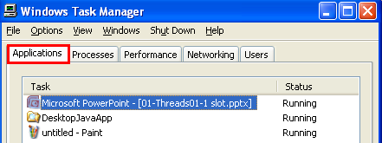
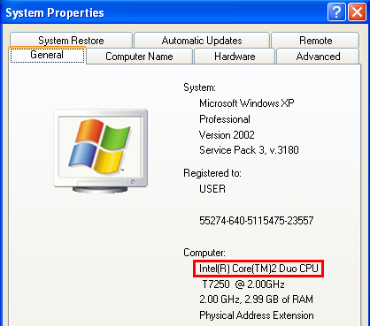
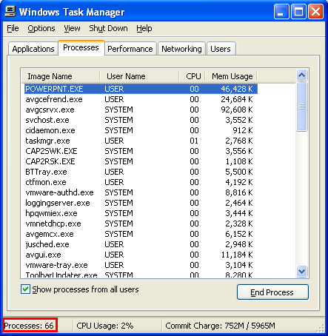
Processes and Multi Processing System…
CPU 2 cores → 1 core runs 33 (66/2) processes
➔ Pseudo -parallelism

Slide 10
Processes and Multi Processing System…
How OS manages processes based on one CPU?
Time-sharing mechanism: OS allows each process running in a time slot (time slice, quantum, about 50 to 70 ms). When this duration expires, another process will be chosen to run → The scheduler (a component of OS, trình lập lịch) will choose the current process.
p3
p2
p1
t

Slide 11
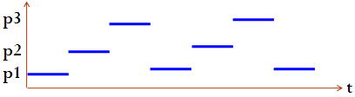
Processes and Multi Processing System… How can OS manage concurrent processes?
Process Table maintains information of processes.
P1
Code
Data
App | Code Addr | Duration (mili sec) | CPU | …
P1 | 30320 | 50 | 1
P2 | 20154 | 60 | 2
P3 | 10166 | 70 | 1
… | … | … | …
… | … | … | …
P2
Code
Data
P3
Code
Data
Time-slicing mechanism. Each process is allocated resources ( CPU, …) for executing in a time-slot (such as 50 milliseconds). When the time duration expires, this process will pause to yield resources to the next process which will be chosen by the scheduler of OS.
Memory

Slide 12
2- Threads and Multi-Threading
Thread, is sometimes called lightweight processes, is a running code unit.
Threads exist within a process — every process has at least one thread (main thread). Threads share the process's resources, including memory and open files. This makes for efficient, but potentially problematic, communication.
Both processes and threads are provided an execution environment, but creating a new thread requires fewer resources than creating a new process.
Multithreaded execution is an essential feature of the Java platform. Threads in a program are managed by the JVM. Scheduler in JVM will choose a current thread.
Notes:
Lightweight (a): nhẹ
Potentially (adv): có khả năng, có tiềm năng

Slide 13
Threads and Multi-Threading … How can JVM manage threads
Thread is a smallest unit code in an application that performs a special job.
➔ A program can have several threads they can be executed concurrently.
App
Data
Code of thread1
Thread Table maintains information of threads
Code of thread2
Thread | Code Addr | Duration (mili sec) | CPU | State
Thread 1 | 10320 | 15 | 1 | ready
Thread 2 | 40154 | 17 | 2 | ready
Thread 3 | 80166 | 22 | 1 | sleep
… | … | … | … | ….
Code of thread3
Memory of a
multi-thread process
Time-slicing mechanism is used to schedule thread executions also.

Slide 14
Threads and Multi-Threading … Processes VS Threads
App1
Data
Code
App1
data
Code
App2
Data
Code
Thread1
Thread2
App3
Data
Code
Thread3
Memory
Memory
Protection mechanism in OS does not allow this process accessing addresses in others
Threads in a process can access common data of this process

Slide 15
Threads and Multi-Threading … Race Conditions
Application
Data 1 (shared data)
Data 2
Data 3
Thread 1
Thread 2
Thread3
Thread 4
Suppose that Thread2 and Thread4 concurrently execute.
Time | Thread 2 | Thread4
1 | Data1=10 | …
2 | …. | …
3 | …. | Data1= 100
4 | …. | …
5 | … | …
6 | Y= 2*Data1; | …
7 |  | …
Y=?
A race
occurs
Need
Synchronization
Notes:
Synchronize –đồng(cùng) bộ(bước chân). Bản chất của sự đồng bộ là sự chờ nhau. Trong tin học, đồng bộ một nhóm tác vụ là cưỡng bức các tác vụ này phải thực thi tuần tự (không cho phép thực thi đồng thời). Giao tiếp đồng bộ là giao tiếp chỉ có một người nói tại một thời điểm (khi phỏng vấn, giao tiếp hình thức). Giao tiếp không đồng bộ là giao tiếp ở đó mọi người đều có thể nói đồng thời (khi cãi lộn).

Slide 16
3- Thread Fundamentals in Java
Threading supports in Java:
The java.lang.Thread class
The java.lang.Object class
The Java language and JVM ( Java Virtual Machine)
How to create a thread in Java?
Create a subclass of the java.lang.Thread class and override the method run()
Create a class implementing the Runnable interface and override the run() method.

Slide 17
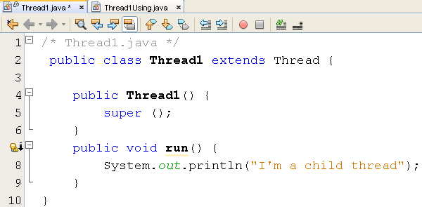
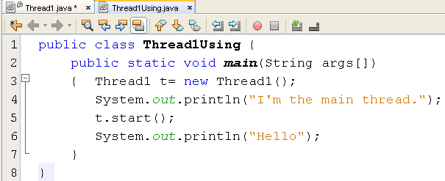
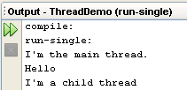
Create a subclass of the Thread class
Thread table
Thread | Code Addr | State | …
main | 8000 | run | …
t | 10320 | run
Every process has at least one thread (main thread).
?
This process has 2 threads running concurrently. At a time, order of their execution is decided by the scheduler.
The start() method is implemented in the Thread class. This method calls the method run().

Slide 18
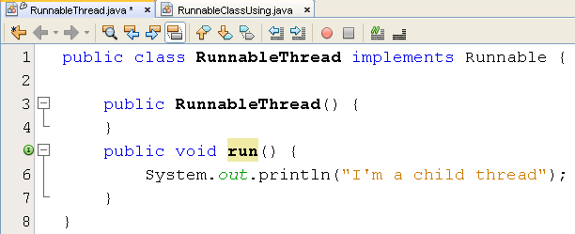
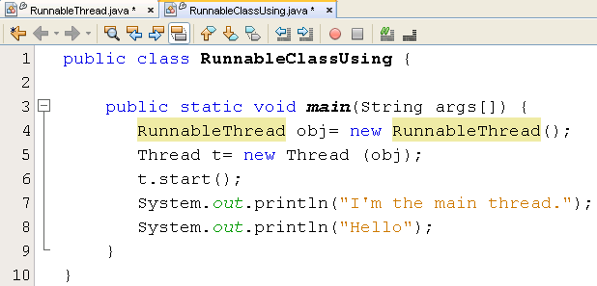

Class implements the Runnable interface
Thread | Code Addr | State | …
main | 8000 | run | …
t | 10320 | run

Slide 19

The java.lang.Thread class
Declaration
public class Thread extends Object implements Runnable
Common Methods
start()
join ()
sleep (milisec)
yield()
notify()
notifyAll()
wait()
Properties
id
name
state
threadGroup
daemon
priority
set/get-is
Constructor
Thread()
Thread(Runnable target)
Thread(Runnable target, String name)
Thread(String name)
Thread(ThreadGroup group, Runnable target)
Thread(ThreadGroup group, Runnable target, String name)
Thread(ThreadGroup group, Runnable target, String name, long stackSize)
Thread(ThreadGroup group, String name)
Notes:
join(): kết hợp → Luồng hiện hành sẽ chạy cho đến khi luồng kết thúc
yield(): nhường → Luồng hiện hành chủ động tạm ngưng, nhường CPU cho luồng khác
notify(): Cảnh báo→ Luồng hiện hành giao tiếp với JVM, yêu cầu JVM cho luồng ở đầu hàng đợi chuyển trạng thái thành ready để khi lập lịch, luồng này sẽ được thực thi. Hành vi notify() thường được dùng ngay sau hành vi wait() → JVM modifies thread table
notifyAll(): cảnh báo tất cả→ Luồng hiện hành yêu cầu JVM cho tất cả các luồng trong hàng đợi được chuyển trạng thái sang ready

Slide 20
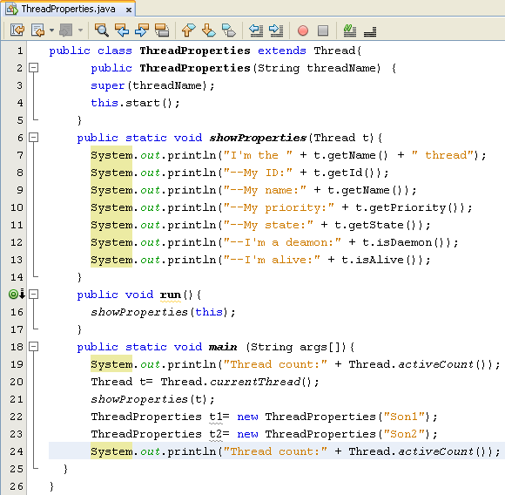
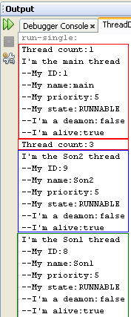
Using some methods of the Thread class

Slide 21
Thread States
Running
wait()
sleep(millisecond)
Blocking method
(IO)
Monitor
States
(JVM)
Suspended
Sleeping
Blocked
yield()
start()
(Scheduler)
Time expired or interrupted
Blocking condition changes or interrupt
notify()
Ready
Interrupt: A signal is sent to CPU from IO device just after an IO operation has terminated.
Only one of ready threads will be chosen by the JVM scheduler at a time.
Ready: As soon as it is created , it can enter the running state when JVM’s processor is assigned to it.
Running: It get full attention of JVM’s processor which executes the thread’s run() method
Dead: When the run() method terminates.
Notes:
Terminate (v): chấm dứt

Slide 22
Summary
Concepts were introduced:
Definitions: Program, Process, Thread
Multi-processing system
Multi-threading programming in Java
Thread Fundamentals in Java
Thread states

Slide 23
Thank You

